Slide 1


The Power of Dividend Investing
Getting paid while you sleep: Building reliable passive income streams through cash-flowing assets.

Slide 2

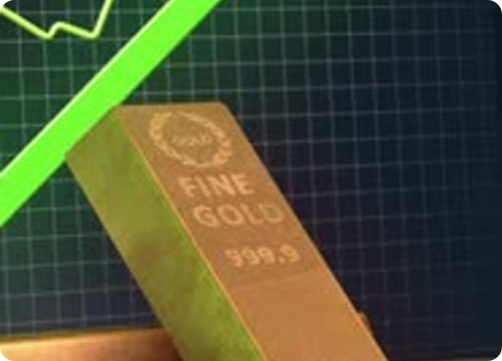

Measuring Cash Flow: Dividend Yield
Dividend Yield is a financial ratio that tells you how much a company pays out in dividends each year relative to its stock price.
The Benchmark: A healthy yield typically ranges between 2% to 6%.
Warning Sign: Extremely high yields (> 10%) can be a "dividend trap" signaling financial distress or a plunging stock price.

Slide 3


The Sustainability Check:
Dividend Payout Ratio
Not all profits are handed back to shareholders. The Dividend Payout Ratio reveals what percentage of a company's net income is distributed as dividends.
Reinvestment vs Payout: Mature utility or banking firms pay out 50-70%. Rapid growth tech companies pay 0%, plowing cash back into R&D.

Slide 4


The Ultimate Goal: Passive Income
Financial Freedom Through Cash Flow
Dividend investing isn't just about quick capital gains; it's about building a machine that generates cash regardless of market direction.
Dividend Reinvestment (DRIP): Automatically using your dividend payouts to purchase more shares, accelerating compound growth exponentially.
The Snowball Effect: Over decades, dividend checks grow large enough to cover your living expenses entirely.

Slide 5
Great Job on Day 18!
Tomorrow: Day 19 - Building a Balanced Long-Term Portfolio.
Don't forget to Like, Share, and Subscribe!
/YourFinanceProfessor
@FinanceProf_Official

Slide 6



Image Sources
https://elements-resized.envatousercontent.com/elements-video-cover-images/28ec7edf-5e8e-474b-86a3-23185859826f/video_preview/video_preview_0002.jpg?w=500&cf_fit=cover&q=85&format=auto&s=a2a49e58f839b6c0d1243b8961de1c64085b813de4d5c5a8fec0975db6c2b176
Source: elements.envato.com
https://static.vecteezy.com/system/resources/thumbnails/052/921/724/small/pie-chart-animation-animated-graph-on-dark-blue-background-suitable-for-business-infographics-financial-reports-market-profits-and-marketing-processes-free-video.jpg
Source: www.vecteezy.com
https://img.magnific.com/free-photo/3d-rendering-money-tree_23-2151575336.jpg?semt=ais_test_b&w=740&q=80
Source: www.magnific.com

